Slide 1
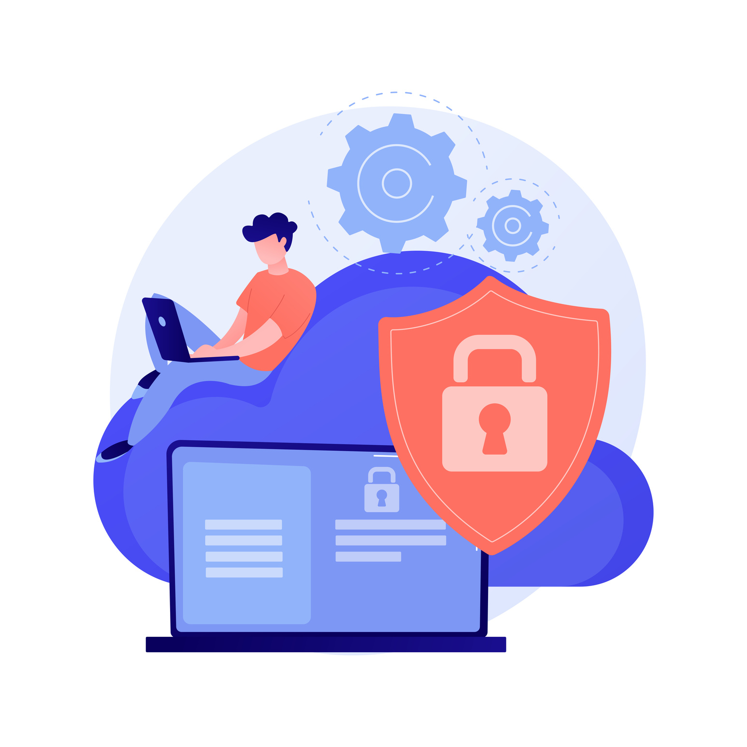


Cyber
Protection
Data
Threat
Security
Attack
Firewall
Malware
SECURITY & PROTECTION
Secure the System, Protect the Core – Because One Breach is All It Takes.
Presented By
Sami,Mustafa and Mariya
Presented to
Dr.Ahmed Awais

Slide 2
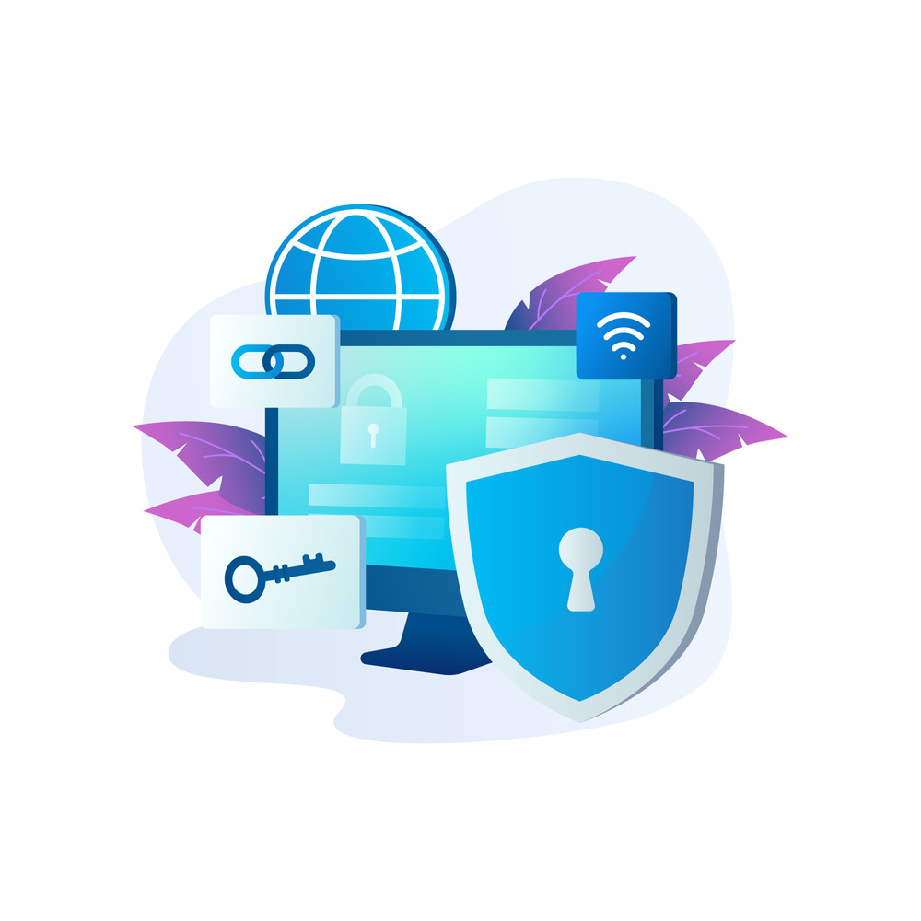

INTRODUCTION
In today's hyper-connected world, operating systems serve as the first line of defense in protecting our digital lives. This presentation dives into two topics: security, which prevents malicious intruders and threats, and protection, which guarantees that processes and users do not step on each other's toes . Whether it's protecting memory, data, or the entire system, these two pillars work together to provide a reliable and robust operating system.

Slide 3
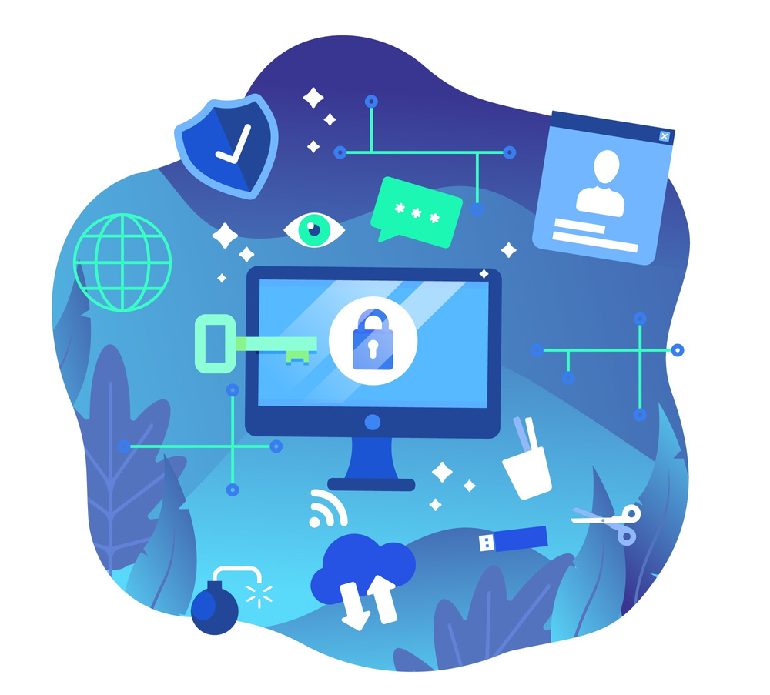
SECURITY
Definition and Goals
Security in operating systems refers to the implementation of mechanisms and policies that protect the system’s resources and data from unauthorized access, misuse, and threats—both internal and external.
Main Goals of OS Security:
Confidentiality – Ensure data is accessible only to authorized users.
Integrity – Prevent unauthorized modification of data.
Availability – Ensure resources and services are available when needed.
Authentication – Verify the identity of users and systems.
Authorization – Control what authenticated users are allowed to do.

Slide 4
SECURITY - REAL LIFE EXAMPLE
1.Login Password or Face ID to Unlock Your Laptop
2.Delete a System File and It Says “Access Denied”
3.“Allow Access to Documents?”
OS Security = The OS checking, limiting, hiding, logging, and protecting stuff — using tools like passwords, permissions, encryption, and firewalls — so your device doesn’t get trashed or abused.

Slide 5

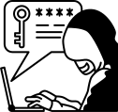




TYPES OF SECURITY THREATS
Malware – Software like viruses, worms, and ransomware that damage or steal data.
Example: WannaCry locking users out of their files until they paid Bitcoin.
Phishing Attacks – Fake emails or messages tricking users into revealing passwords or personal data.
“Click this link to update your bank info”… yeah, don't.
Denial of Service (DoS) – Flooding a system with traffic to crash it or make it unavailable.
Imagine 100,000 fake login requests at once — boom, system overload.
Insider Threats – Authorized users misusing access to steal or corrupt data.
Sometimes the real danger’s already logged in.
Zero-Day Vulnerabilities – Bugs the developer doesn’t know about but hackers do.
“Zero-day” = zero time to patch it.

Slide 6
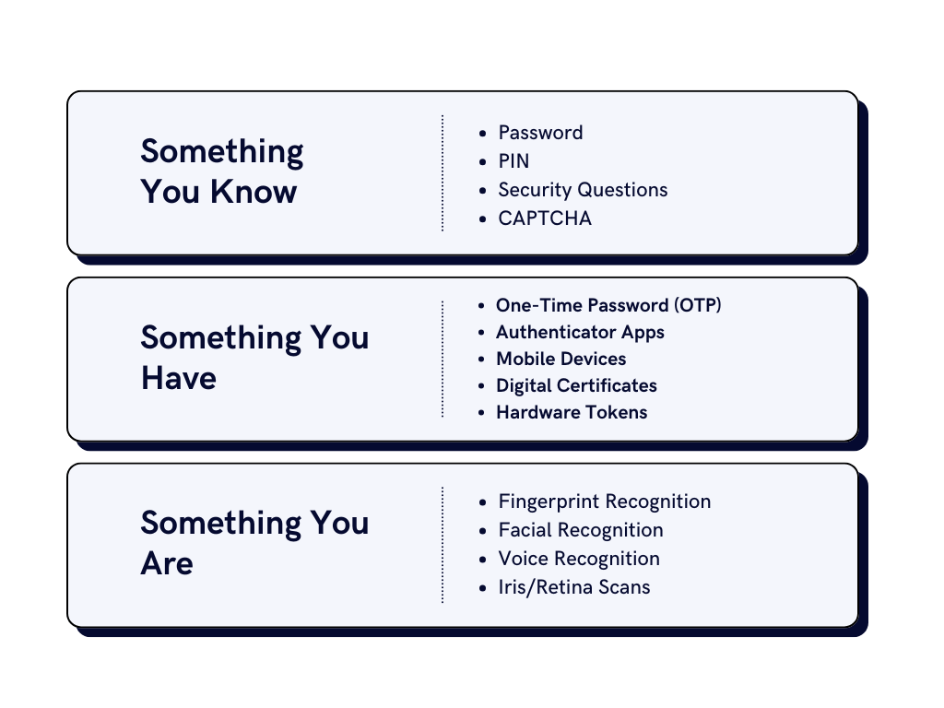

AUTHENTICATION METHODS IN OPERATING SYSTEM

Slide 7

ENCRYPTION
Encryption is the process of converting readable data (plaintext) into a scrambled, unreadable form (ciphertext) to protect it from unauthorized access. Only someone with the decryption key can turn it back into its original form.
Types of Encryption:
Symmetric Encryption
Asymmetric Encryption
Hashing
Hybrid Encryption

Slide 8
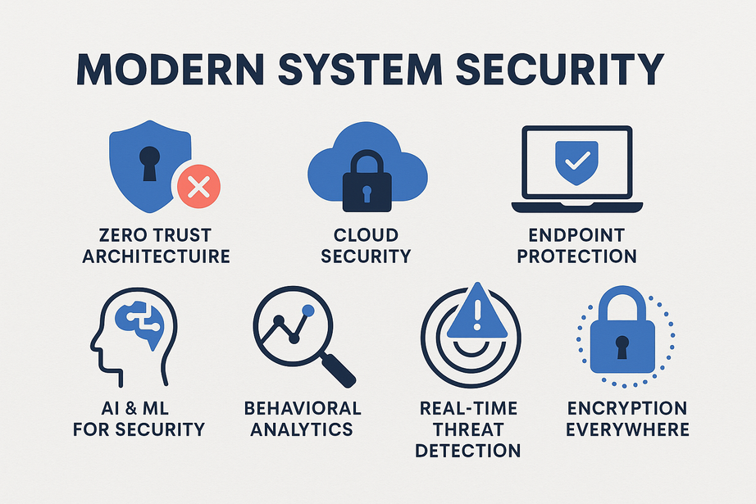
MODERN SYSTEM SECURITY
Modern System Security refers to the advanced techniques and practices used to protect today’s complex computing systems (like cloud platforms, IoT, mobile apps, and AI-driven systems) against evolving and sophisticated cyber threats.

Slide 9
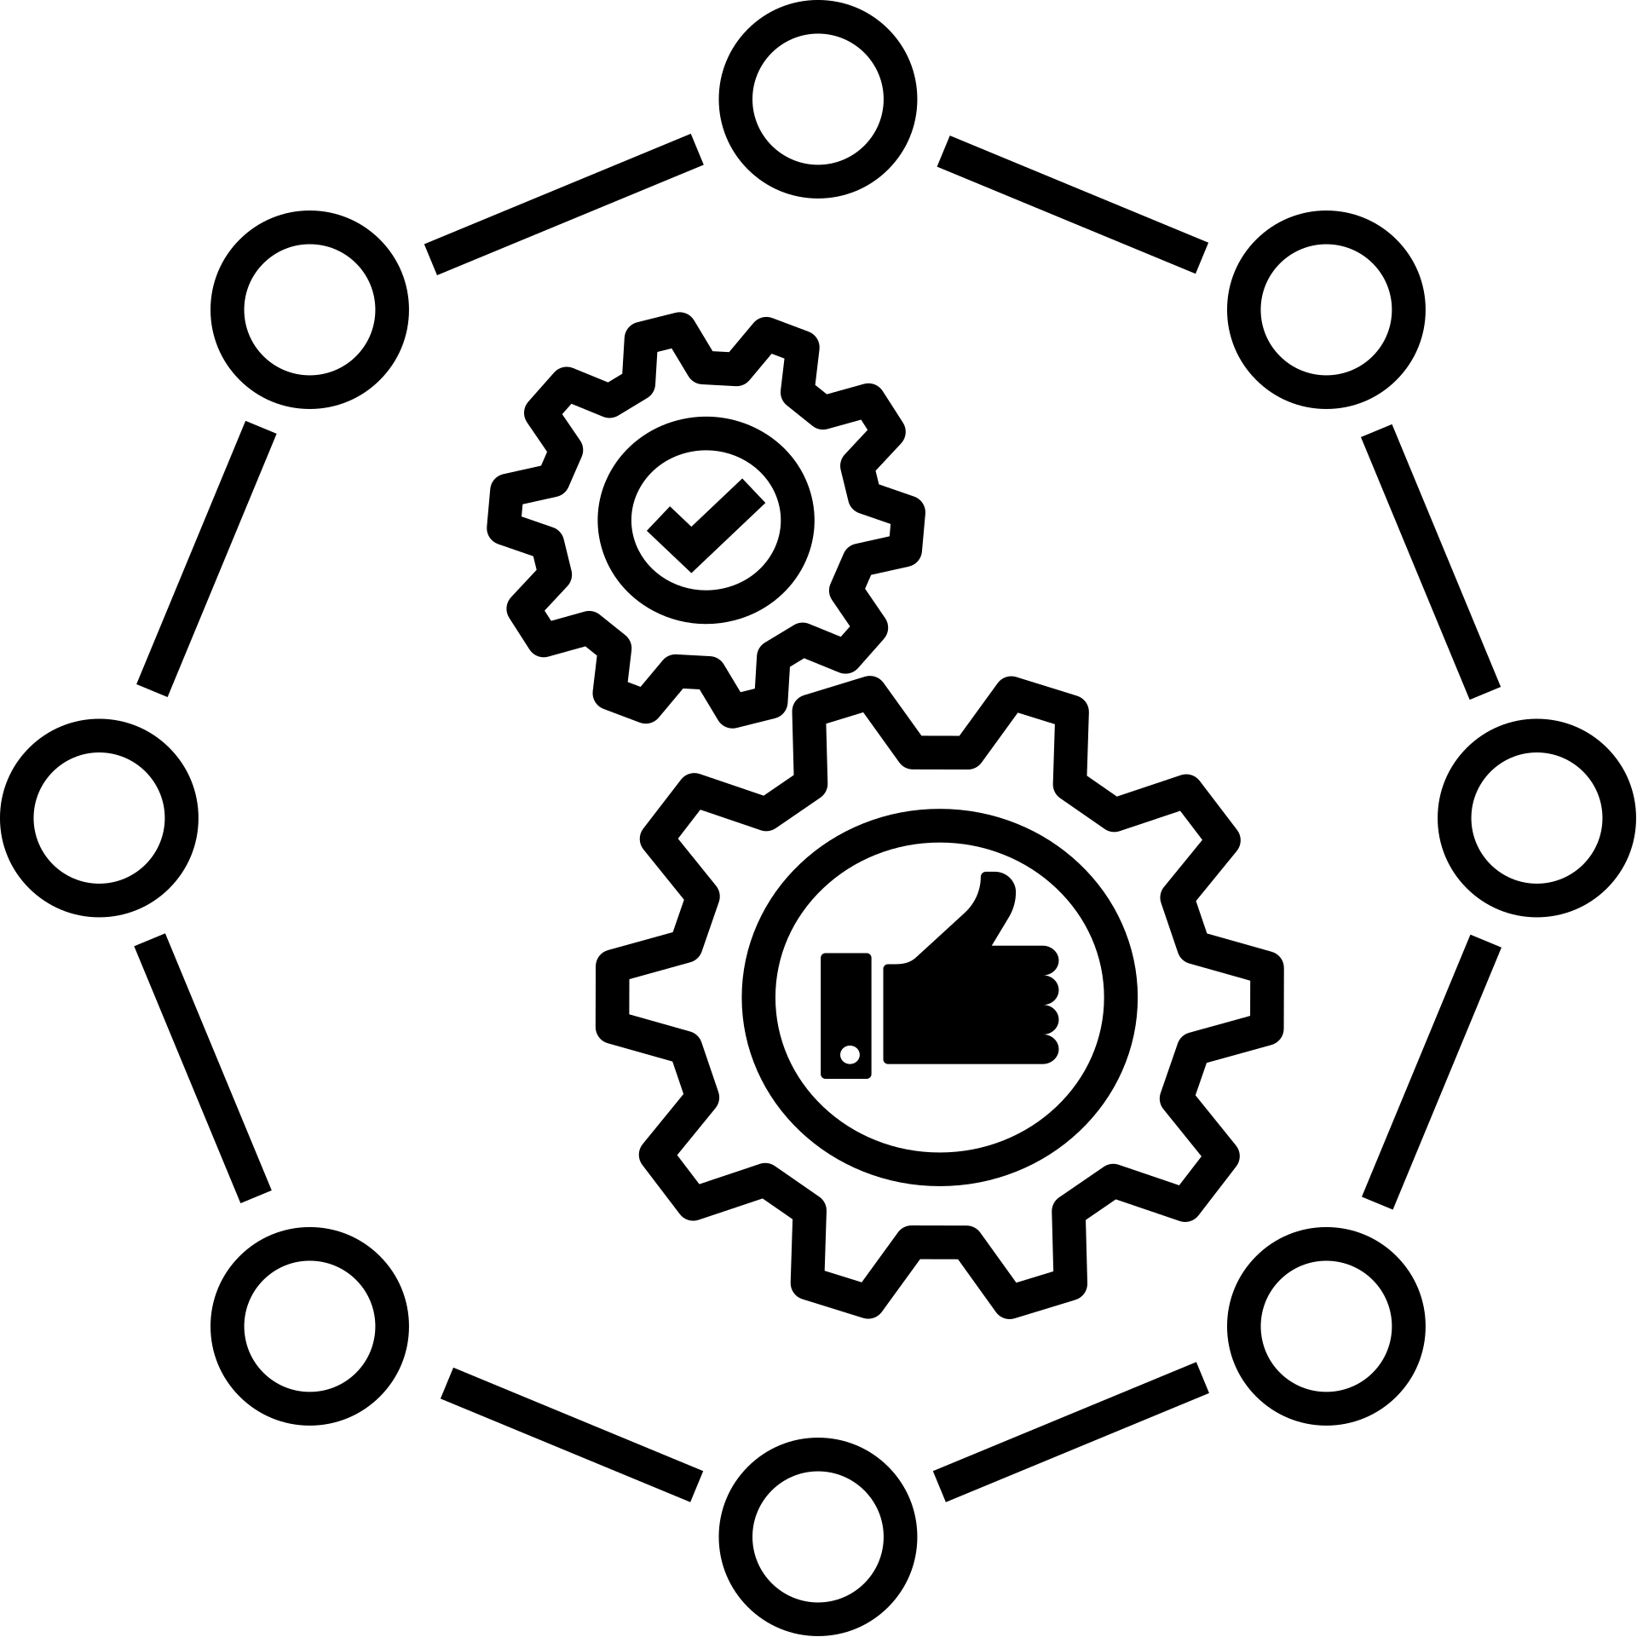
TRUSTED OPERATING SYSTEMS
OSes with built-in, certified security features used in military and finance to protect critical systems.SE Linux,TrustedBSD,INTEGRITY-178B in military and in finance IBM AIX,z/OS are vividly recognized.

Slide 10
FIREWALLS AND IDS
Firewall
A firewall is a network security system, either hardware or software-based, that monitors and controls incoming and outgoing network traffic based on predefined security rules.
Example:
A firewall can be configured to block all traffic from certain IP addresses known for distributing malware, or to allow only HTTPS traffic for secure web browsing.
Intrusion Detection System (IDS)
An Intrusion Detection System (IDS) is a security tool used to detect unauthorized access or abnormal activity within a computer system or network, alerting administrators to potential threats in real time.
Example:
If a user attempts to log in to a server 100 times in one minute, the IDS will detect this suspicious behavior and raise an alert for a possible brute-force attack.

Slide 11
PROTECTION
Definition and Goals
Protection in an operating system refers to the set of mechanisms that regulate access to computer system resources — ensuring that only authorized users or processes can access or modify data, files, or memory.
Goals of Protection:
Prevent Misuse
Enforce Access Rules
Data Integrity
Isolation
Fair Resource Use

Slide 12
PROTECTION - REAL LIFE EXAMPLE
1.Files Are Private, Even on a Shared Laptop
2.One App Can’t Read Another App’s Data
3.File Permissions: Read, Write, Execute
It's about making sure that:
Apps don't mess with each other
Users can’t access or break things they shouldn't
Everyone gets to use resources safely and fairly
One bad move doesn’t crash the whole system

Slide 13
IMPLEMENTATION TECHNIQUES
In the context of Protection in Operating Systems, implementation techniques are the practical ways the OS enforces control over access to memory, files, devices, and other resources. These include both software and hardware mechanisms.
Major Implementation Techniques :
Access Control Lists (ACLs)
Capability Lists
Role-Based Access Control (RBAC)
Security Policies & Models
Domain Switching

Slide 14
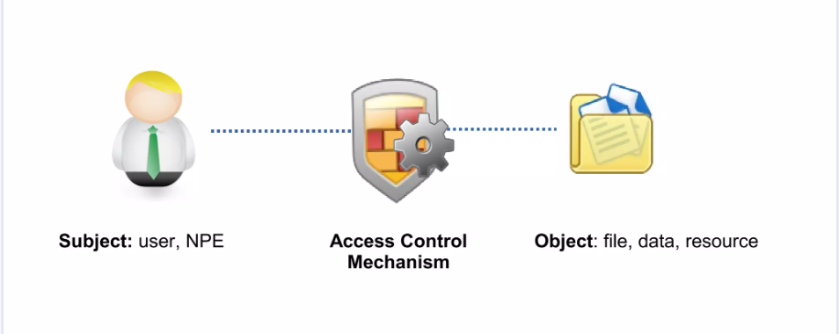
ACCESS CONTROL MECHANISMS
An access control mechanism is a security safeguard designed to detect and deny unauthorized access and permit authorized access to an information system or physical facility.

Slide 15
SECURITY POLICIES & MODELS
Security policies are formal rules that specify what is and is not allowed in a system. They serve as the "constitution" of a secure system, establishing confidentiality, integrity, and access control objectives.
Security models are mathematical or structural frameworks that aid in the implementation and enforcement of policies. They define how access is provided or refused according to specified rules.
Common Security Models:
Bell-LaPadula (BLP): Focuses on confidentiality — “No read up, no write down.”
Biba Model: Focuses on integrity — “No write up, no read down.”
Clark-Wilson: Enforces data consistency and integrity for commercial/business systems.

Slide 16
ROLE BASED ACCESS CONTROL
Role Permissions:
Admin
Install, Delete, Modify
Teacher
View/Edit Grades
Student
Submit/View Only
RBAC is a security technique that assigns permissions to roles rather than persons. Users are granted access based on their position in a system, making permission management easier and scalable.
Why RABC is important:
simplifies access control in big systems
reduces human error
facilitates onboarding and offboarding people.

Slide 17

DOMAINS OF PROTECTION
A Domain of Protection is a boundary that defines what a user or process can access and what operations it can perform on system resources (like files, devices, memory, etc.). User Domain,Admin Domain,Browser Process Domain,Printer Process Domain are some of the populer domains. Switching from one protection zone to another — like going from student to admin mode.

Slide 18
SECURITY VS PROTECTION
Keeps outsiders out
Focuses on threats like hackers
“You can’t come in!”
Example: Login screen blocks strangers
Keeps insiders in line
Focuses on fair and safe resource use
“You can’t do that once you're in!”
Example: You can’t edit system files as guest

Slide 19
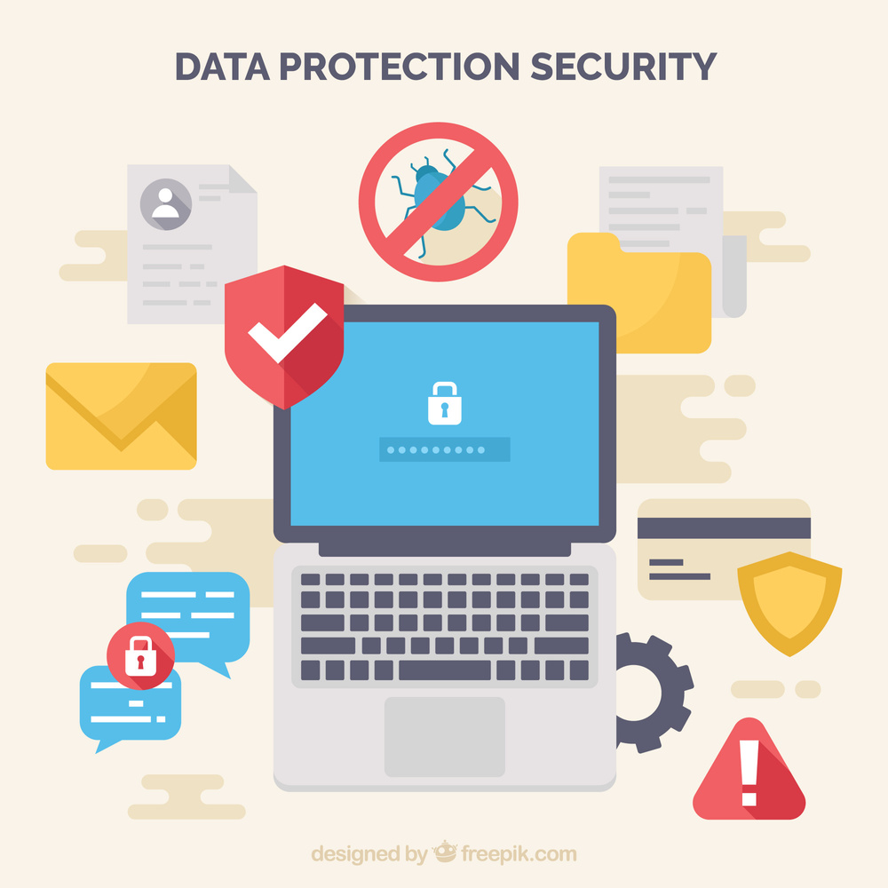
CONCLUSION
The Future of Security & Protection
AI-driven threat detection, Zero Trust models, and quantum-resistant encryption will influence the future of operating system security in response to growing cyber threats. Hardware-based security (such as TPM 2.0) and self-healing systems will reduce the need for human involvement. Privacy-conscious designs (e.g., minimum data acquisition) and stronger rules (such as GDPR) will need openness. To avoid vulnerabilities, IoT and edge devices will use lightweight, secure kernels. Eventually, operating systems will develop into adaptable, unhackable environments that prioritize both security and user privacy as default. In the future, OS security won’t just protect us. It’ll outsmart the attackers — in real time.

Slide 20

Cyber
Protect
Data
Threat
Security
Attack
Firewall
Malware
THANKYOU
As future engineers, it’s not just our job to build systems — it’s our duty to protect them.
UNLOCKED

